Slide 1
Battle of the Neighborhoods
Dhivya dharani

Slide 2
Location analysis for opening a New Restaurant in Chennai

Slide 3
Introduction
This project explores the best locations for opening a restaurant in Chennai city
Food Business is always the best one. Since there are a lot of Restaurants available, analysis is required to find out the affordable area and to find out available venues in the area.
This report explores which neighborhoods of Chennai and their land values per Sq. Ft and most common venues in each neighborhood.
The result is grouped to 5 groups based on the area prices.

Slide 4
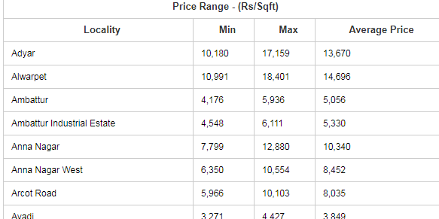
Data
Chennai locations and land prices are taken from https://www.livechennai.com/Propertyratesinchennai.asp
Sample Data

Slide 5
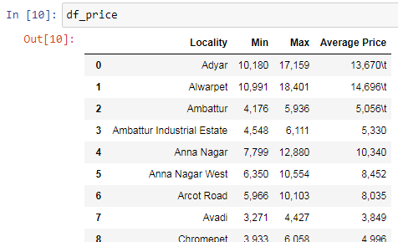
Loading of Data
Data is loaded into Data frame.

Slide 6
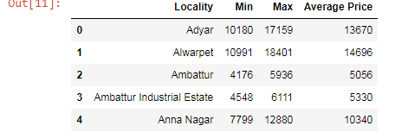
Data Processing
Data loaded into df is processed like removing the special characters, converting string to number.
Processed Data:

Slide 7
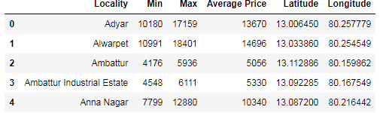
Methodology
Location coordinators are obtained by geolocator.

Slide 8
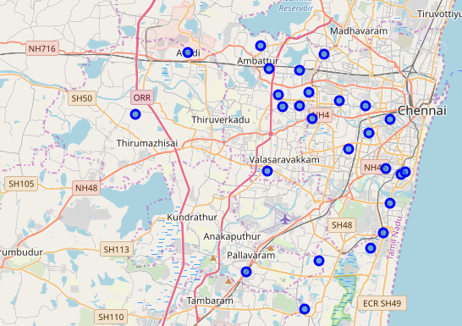
Map
Locations are plotted in map.

Slide 9
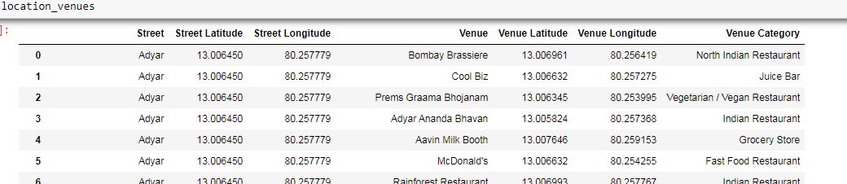
Foursquare API
Foursquare API is used to fetch the venues in the given areas.

Slide 10
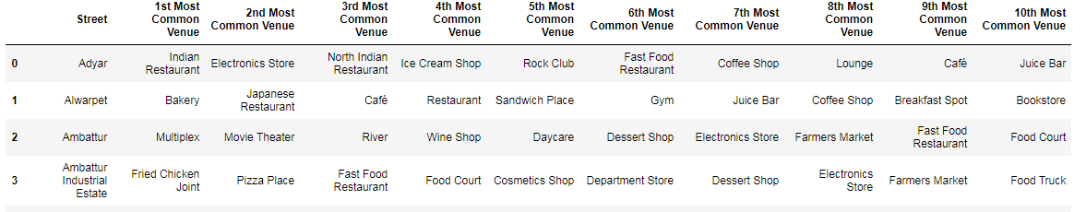
Grouping data
Finding top most venues for the neighborhood.

Slide 11
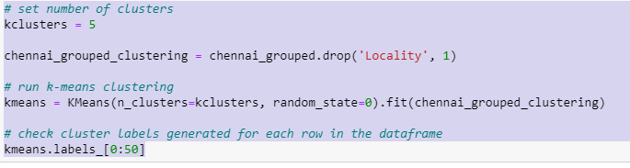
Clustering of Data
Using K-Means, clustering the data based on Land Average price.

Slide 12
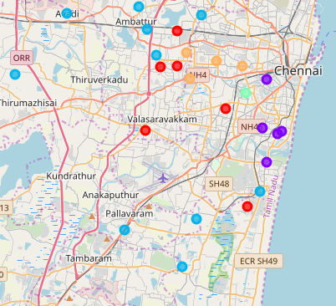
Plotting the Clusters

Slide 13
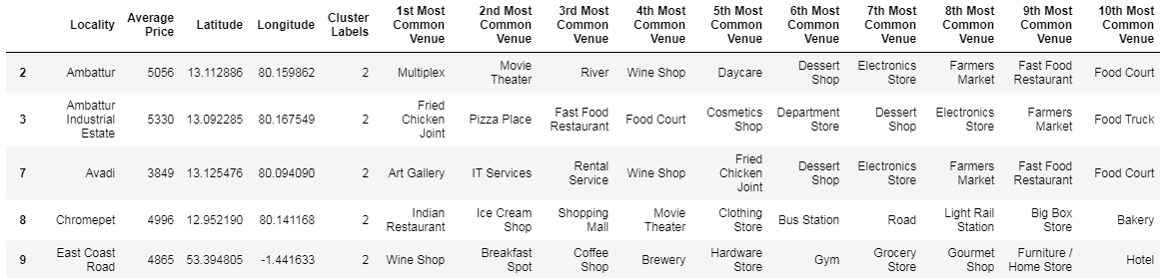
Result
With the grouping we find the locations under cluster affordable range and also there is less number of restaurant compared to other clusters.

Slide 14
Conclusion
With the above analysis we came to conclusion of which are best locations for opening a restaurant in Chennai.

Slide 15
Thank you

